Slide 1
Software Construction and Development
Exception Handling
Maria Kiran
Email: maria.kiran@ucp.edu.pk
Office: Building A, Faculty Hall F202
OFFICE HOURS: Tue, Wed, Thu (9:00 to 11:00)

Slide 2
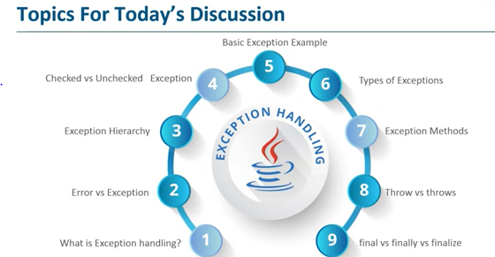

Slide 3
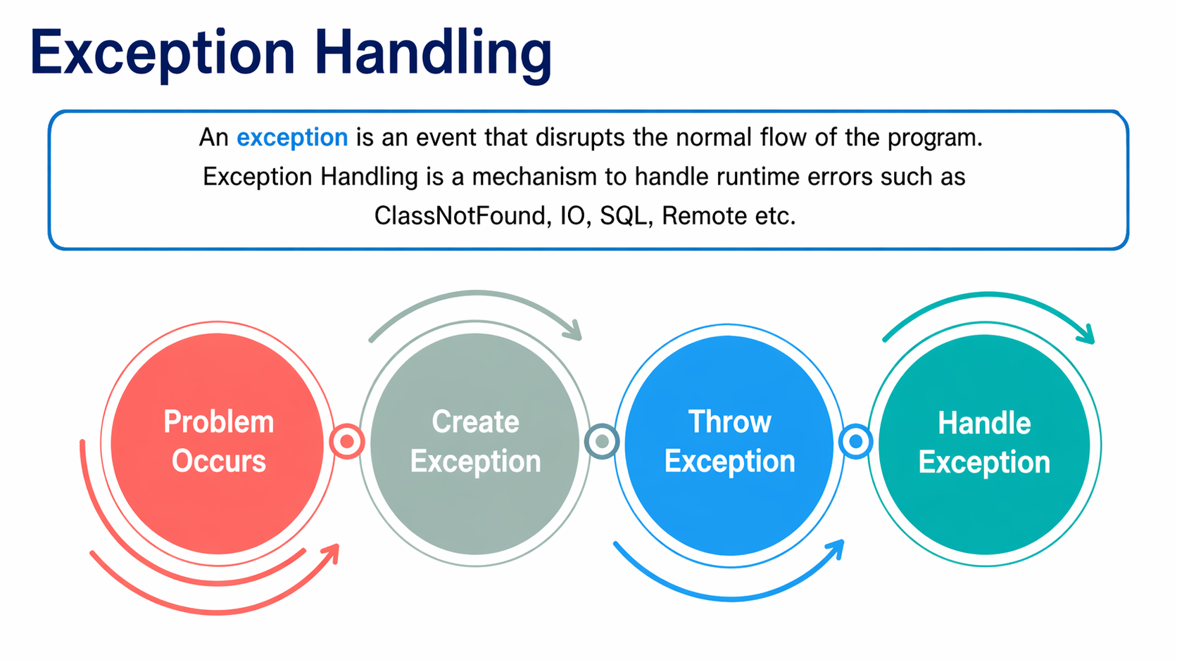

Slide 4
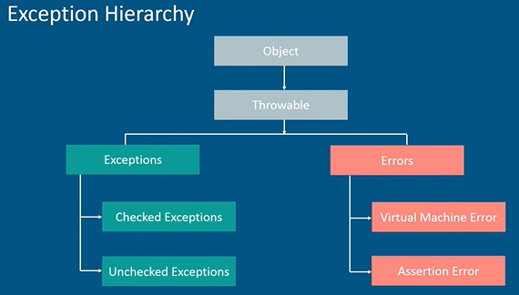

Slide 5
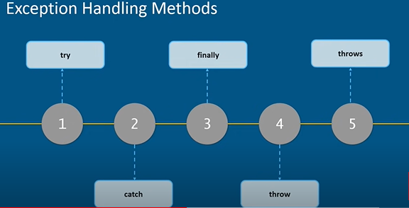

Slide 6
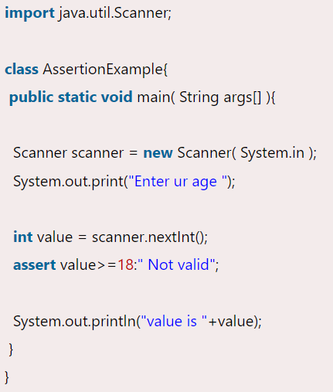
Assertion & Assertion Error in Java
Assertion is a statement in java. It can be used to test your assumptions about the program.
While executing assertion, it is believed to be true. If it fails, JVM will throw an error named AssertionError. It is mainly used for testing purpose.
It provides an effective way to detect and correct programming errors.

Slide 7
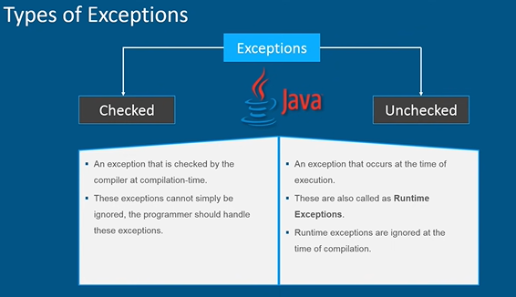

Slide 8
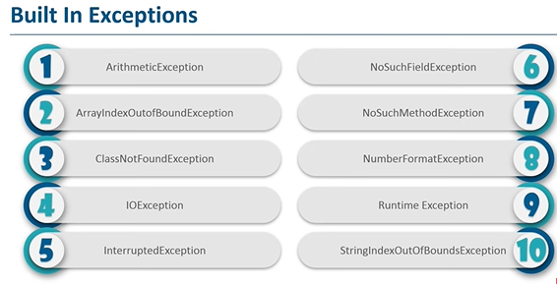

Slide 9
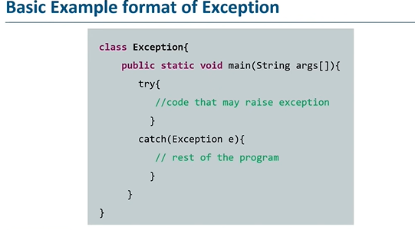

Slide 10
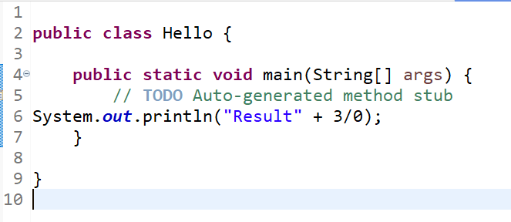
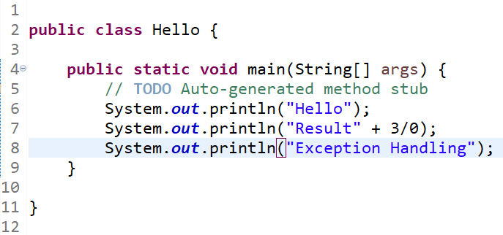

Example of Exception

Slide 11
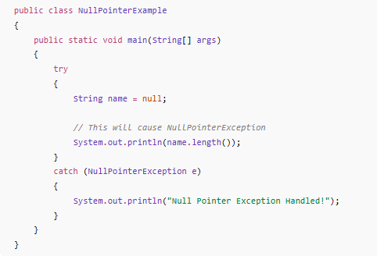
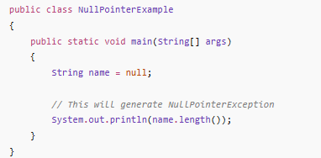
Null Pointer Exception
What happens?
name is null (it does not point to any object)
Calling length() on it throws a NullPointerException

Slide 12
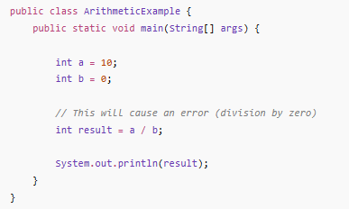
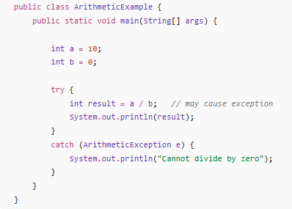
Arithmetic Exception
ArithmeticException handling using try catch
What happens?
You are dividing by zero
Java throws an ArithmeticException

Slide 13
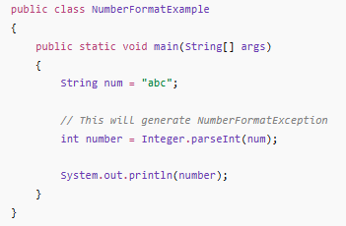
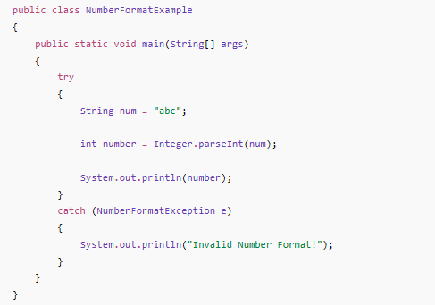
Number format Error

Slide 14
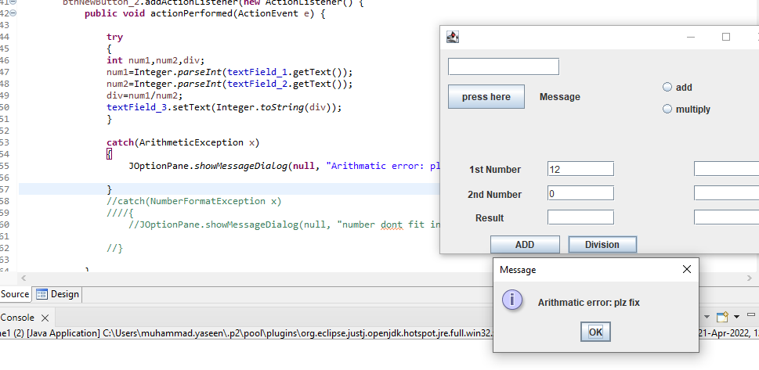
Exception: Arithmetic

Slide 15
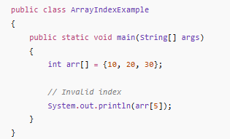
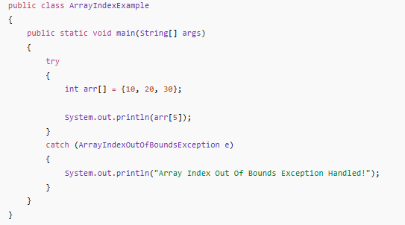
Array index out of bound

Slide 16
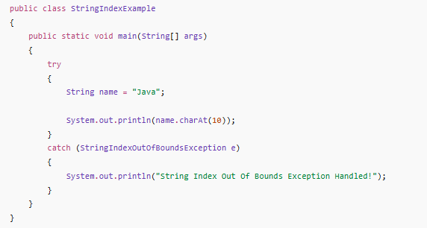
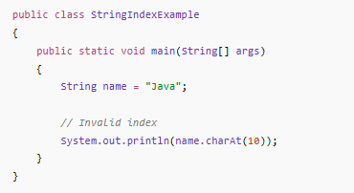
String index out of bound

Slide 17
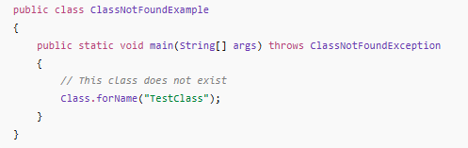
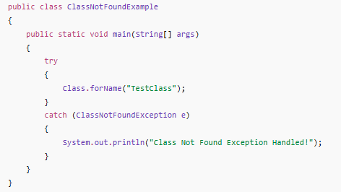
No Class Found Exception
Notes:
Explanation
Class.forName() is used to load a class dynamically at runtime.
"TestClass" is the name of the class Java is trying to find.
If the class exists, Java loads it successfully.
If the class does not exist, Java throws ClassNotFoundException.

Slide 18
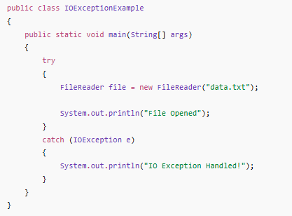
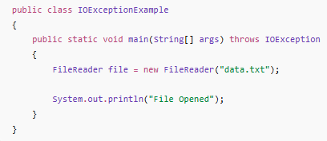
I/O Exception

Slide 19
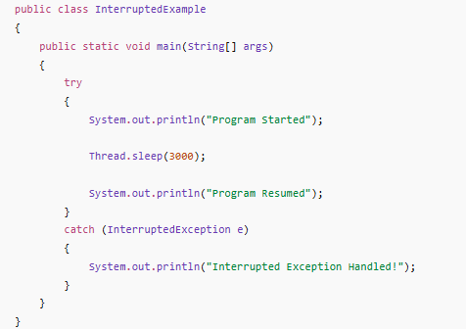
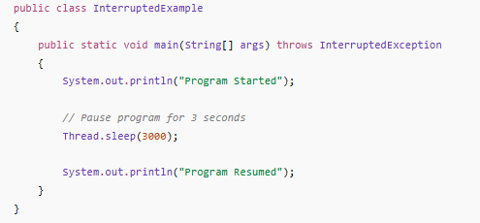
Interrupted Exception
Notes:
Pauses the program for 3000 milliseconds (3 seconds)
During sleep, if another thread interrupts the current thread, Java throws InterruptedException

Slide 20
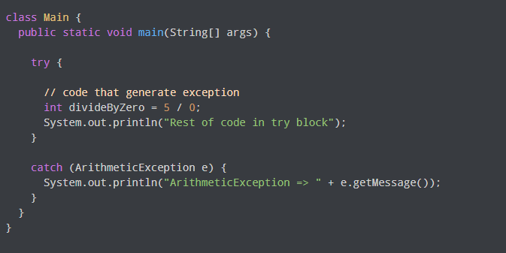
Try-catch

Slide 21

Feature | final | finally | finalize()
Type | Keyword | Block | Method
Use | Restrict changes | Cleanup after try-catch | Cleanup before GC
Runs when | At compile time | Always after try-catch | Before object is destroyed
Example | final int x = 10; // x = 20; ❌ error | try { int a = 10 / 0; } catch (ArithmeticException e) { System.out.println("Error"); } finally { System.out.println("Always runs"); } | class Test { protected void finalize() { System.out.println("Object destroyed"); } }
Notes:
GC: Garbage Collector

Slide 22
Throw vs Throws
Feature | throw | throws
Purpose | To actually throw an exception | To declare an exception
Usage | Inside method body | In method signature
Type | Single exception object | One or multiple exceptions
Example | public class ThrowExample { public static void main(String[] args) { int age = 16; if (age < 18) { throw new ArithmeticException("Not eligible"); } System.out.println("Eligible"); } } | public class ThrowsExample { static void check() throws Exception { throw new Exception("Error occurred"); } public static void main(String[] args) { try { check(); } catch (Exception e) { System.out.println(e.getMessage()); } } }

Slide 23
Introduction to Logging
What is Logging?
  Logging means recording program activities/messages
Helps track:
  Errors
  System behavior
  Debugging info
Example
  System.out.println("Program started");
  ❌ Not recommended for real applications

Slide 24
Why Logging is Important?
Problems with System.out.println()
  No control over output
  Cannot manage levels
  Not suitable for large systems
Benefits of Logging
  Different log levels (INFO, ERROR, etc.)
  Can save logs in files
  Helps in debugging & maintenance
  Used in real-world applications

Slide 25
What is SLF4J?
SLF4J (Simple Logging Facade for Java) is a logging interface
  It provides a standard way to log messages
Important Point
  SLF4J does not log itself
  It works with backends like:
    Logback
    Log4j

Slide 26
Log Levels in SLF4J
Level | Purpose
TRACE | Detailed debugging
DEBUG | Developer debugging
INFO | General information
WARN | Warning message
ERROR | Serious issue

Slide 27
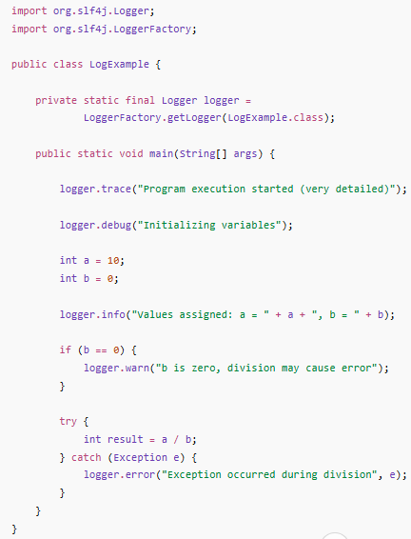
Log Levels in SLF4J (Code Example)

Slide 28
SLF4J Setup in Eclipse (Step-by-Step Guide)
Step 1: Download Required JAR Files
Download these two files:
slf4j-api
slf4j-simple (this is the logging backend)
Example files:
slf4j-api-2.x.jar
slf4j-simple-2.x.jar
Step 3: Add JAR Files to Project
Right-click on your project
Click Build Path → Configure Build Path
Go to Libraries tab
Click Add External JARs
Select both downloaded JAR files
Click Apply and Close
Step 2: Create Java Project in Eclipse
Open Eclipse
Go to File → New → Java Project
Enter project name (e.g., LoggingDemo)
Click Finish
Step 4: Create Java Class
Right-click on src
Click New → Class
Name it LogExample
Click Finish

